Slide 1
Creating Digital Portfolios Using FreshGrade
By Jackie Turner & Leah Mathewson
EDCI 336, 2021

Slide 2
FreshGrade is a commonly used assessment tool in Elementary schools throughout BC.
Assessment is the central function of FreshGrade however there are a variety of way in which a teacher can use it.
Our inquiry dives into the use of FreshGrade as an organizational tool for the teacher that directly links their calendar with the lesson plan’s student activity, thus creating a digital portfolio for each student success in the lesson.
The digital portfolio for each lesson/unit is easily accessible for assessment in the Gradebook.
Each activity can be customized to reflect the assessment method of the teacher’s choice, including the standard proficiency scale or letter grades.

Slide 3
Why use FreshGrade?
It supports inclusive education and student autonomy
Can easily adjust to remote or hybrid models of education
Promotes student-centred learning
Links to BC curricular competency scale
Highly collaborative for both family and co-teaching environments
Logo use complies with Freshgrade branding guidelines at https://freshgrade.com/company/media-kit/

Slide 4
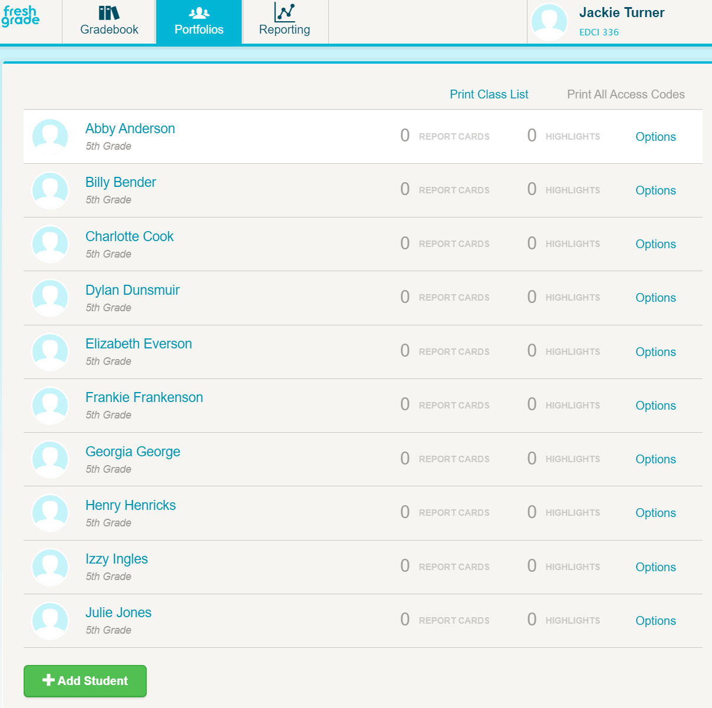
Setting up your classroom in Freshgrade:
Step 1: From your account settings, click '+ Create New Class'
Step 2: Fill in the following information to create your new class:
Class Name
Learning Outcomes
Grade level
Subjects
Step 3: Next, add your students. You can do this two different ways:
Enter names manually
Import a list
Step 4: Select the 'Portfolios' tab in the top toolbar to view to your Student Overview page.
If the student likes, a photo can be uploaded to their portfolio.

Slide 5
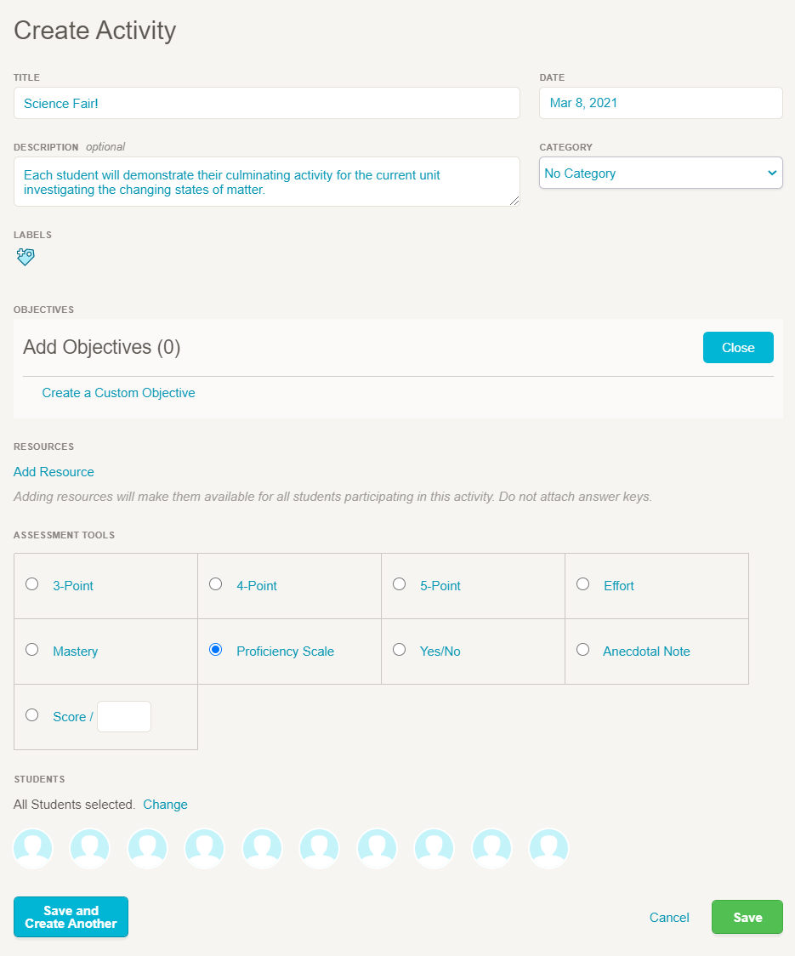
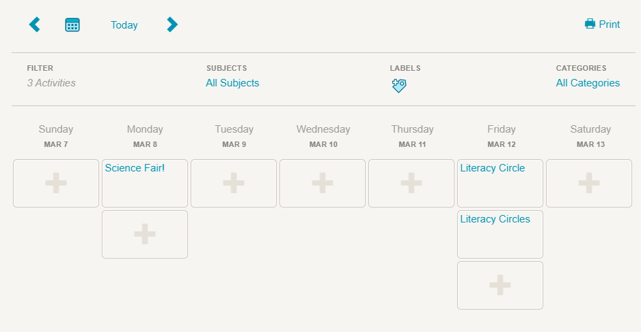
Setting up your calendar in FreshGrade:
Freshgrade can be used as an organizational tool by managing lesson and unit plans from either the calendar or the gradebook directly.
You can set up a class for each subject with its own gradebook, or manage all classes from one gradebook.
Teachers can organize themselves by setting up each lesson plan via an “activity”, which is any lesson plan you want to track and/or assess within a student’s portfolio.
Step 1: To create an activity, select either the 'Gradebook' or “Calendar” tab in the top toolbar. Then select 'Create Activity.'
Step 2: Fill in the necessary information to create an activity
Step 3: Choose your assessment tool. You can use a default tool or create your own custom assessment tool.
Step 4: Select your students. You can choose the entire class, or select specific students who will be completing this activity.

Slide 6
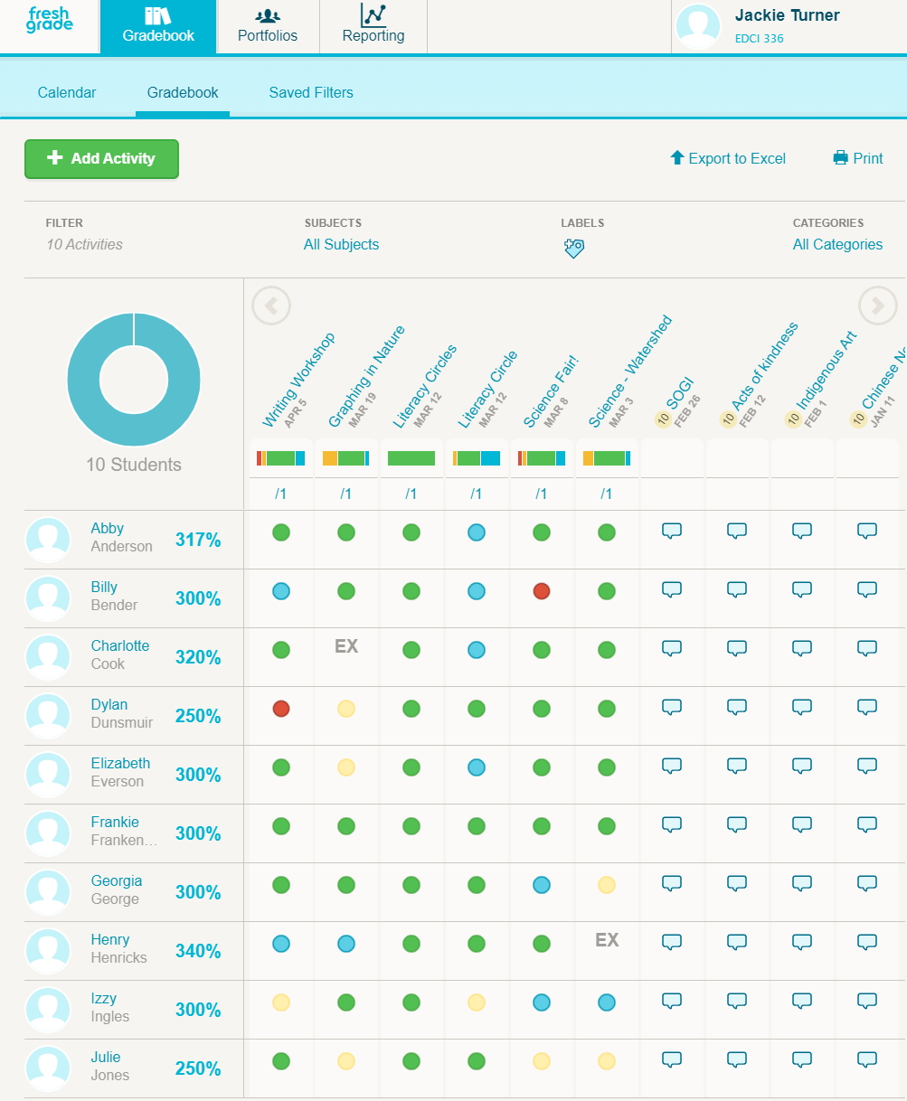
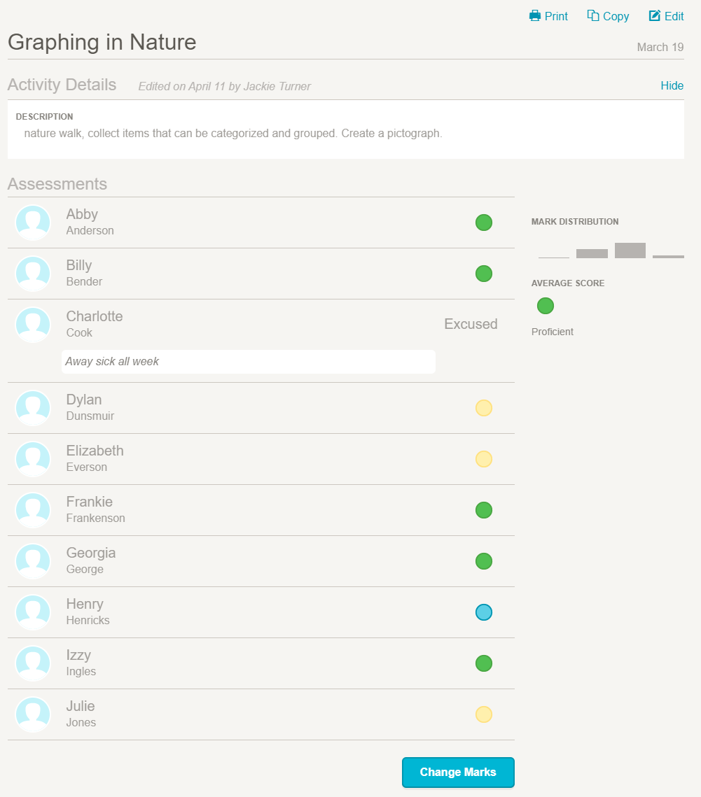
Student Digital Portfolios:
The gradebook allows you to see the class results at a glance for each activity.
You can also filter by student or activity
When you filter by activity, you can view class results, trends and averages
When you filter by student, you can see their individual portfolio

Slide 7
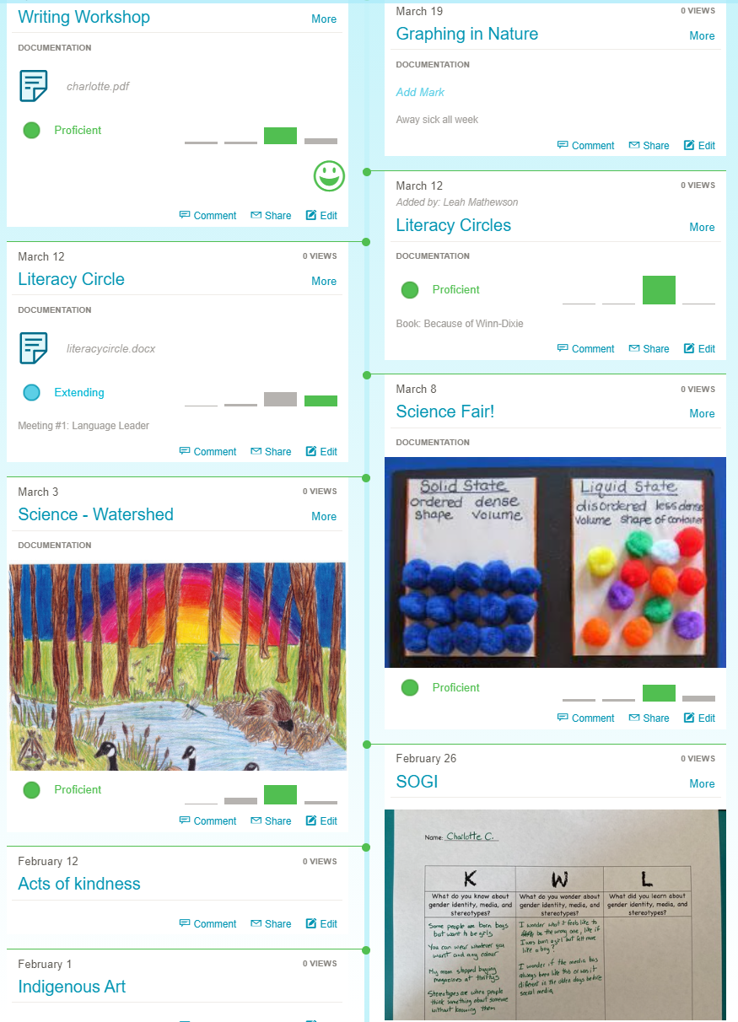
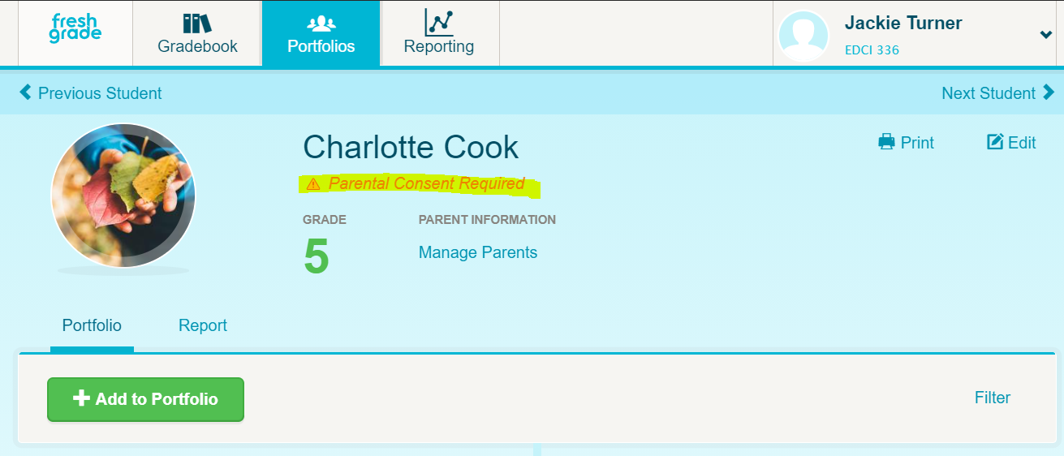
Let’s look at Charlotte’s portfolio more closely:
Before going any further, ensure you have signed parental consent
filed with the school allowing Freshgrade to be used for Charlotte.
Share FreshGrade Privacy policies with the parents, https://freshgrade.com/privacy-policy/
For students whose family has not provided consent, use a paper portfolio without saved images

Slide 8
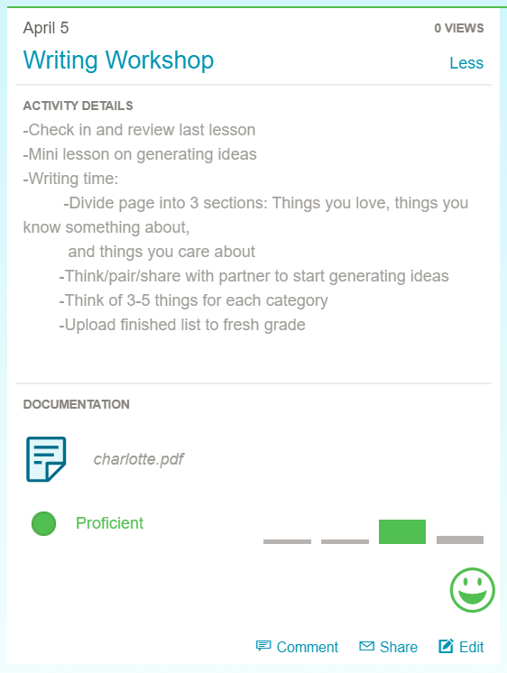
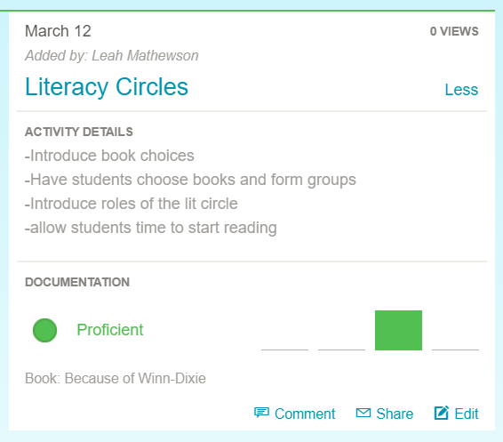
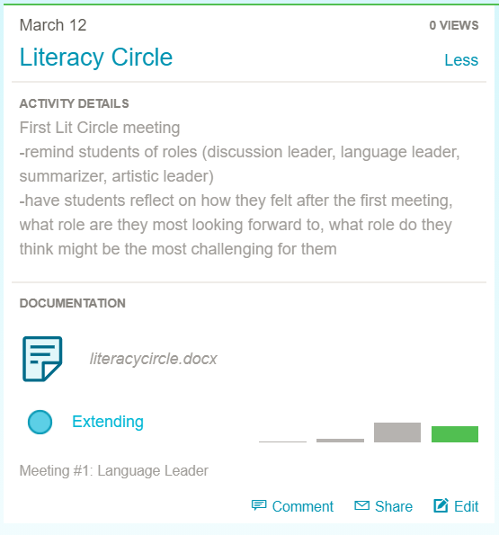
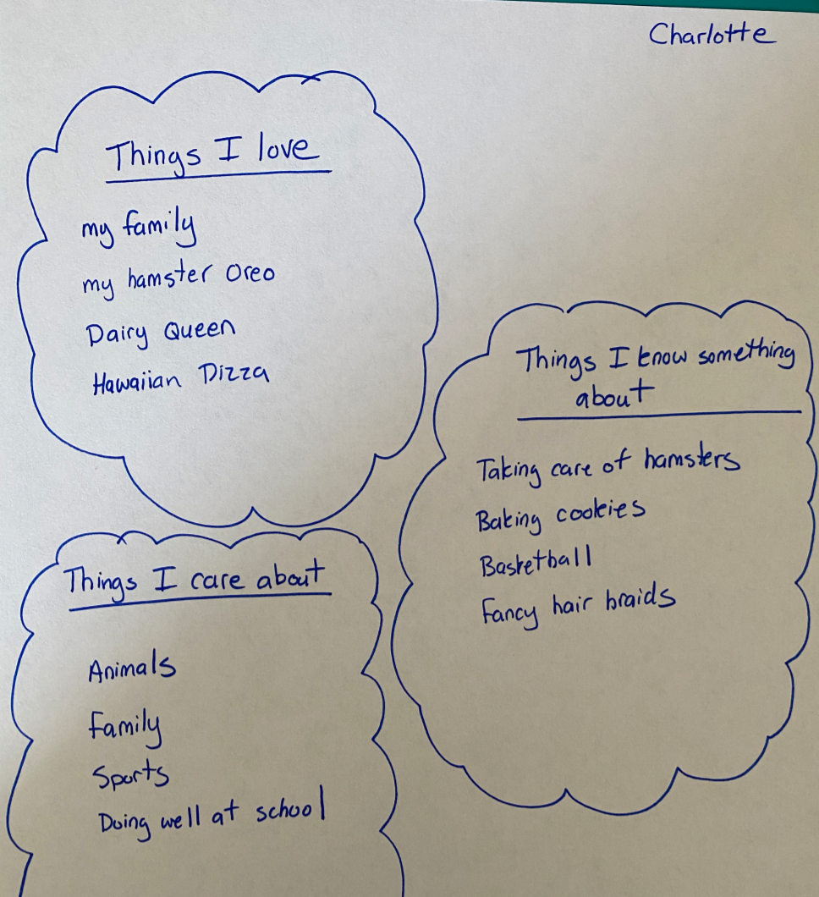
Charlotte’s portfolio

Slide 9
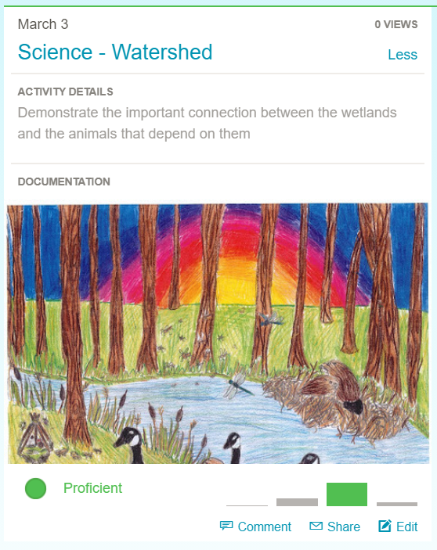
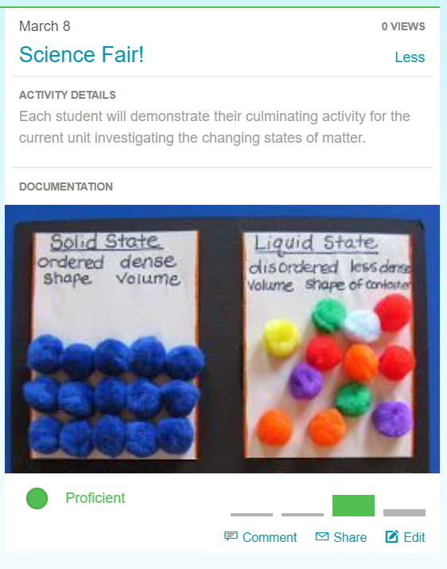
Charlotte’s portfolio

Slide 10
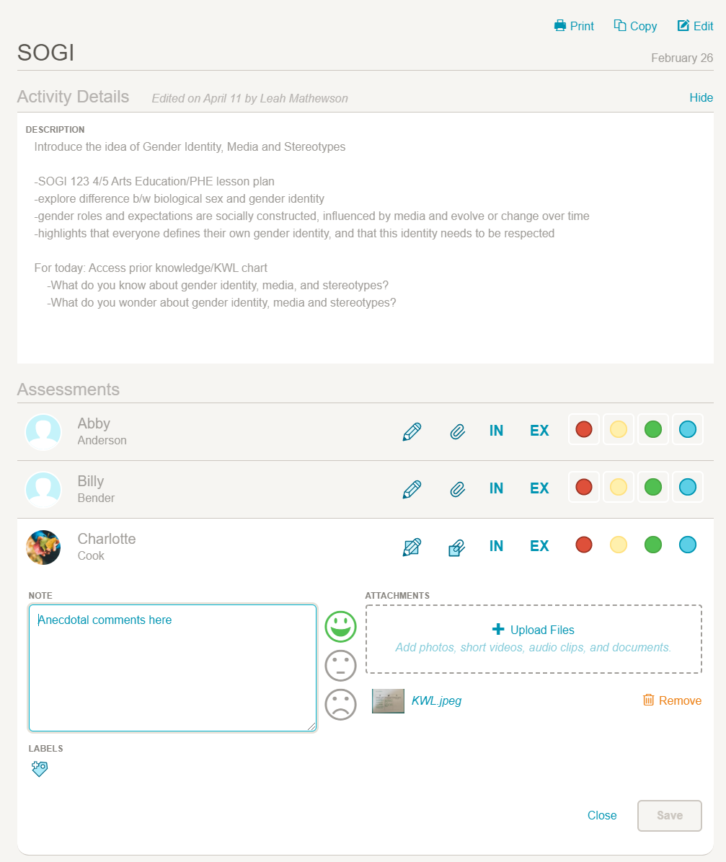
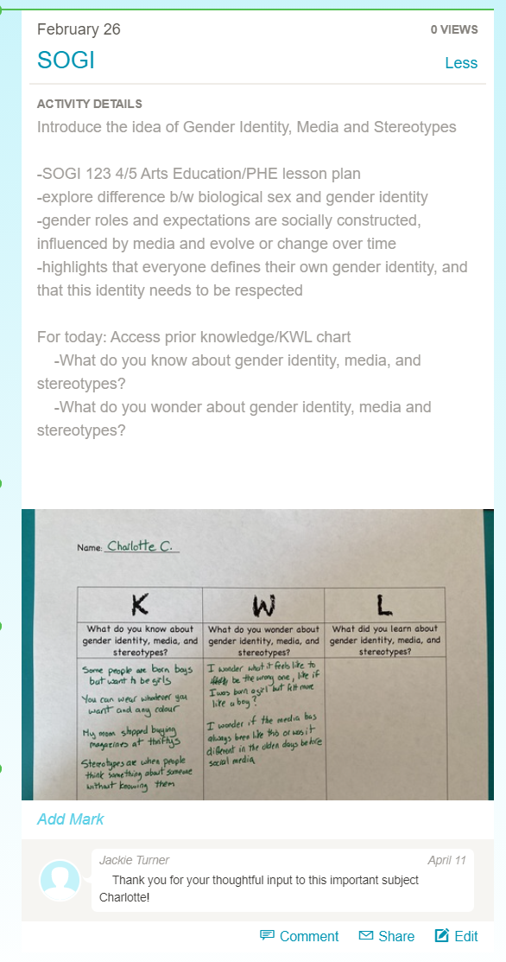
For courses that are only anecdotally assessed, teachers can add a comment into the documentation submitted for that class.

Slide 11
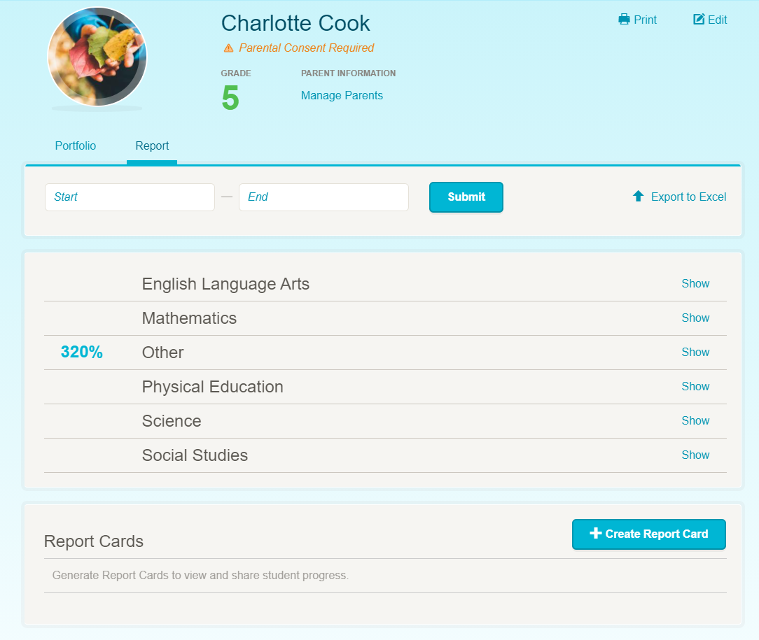
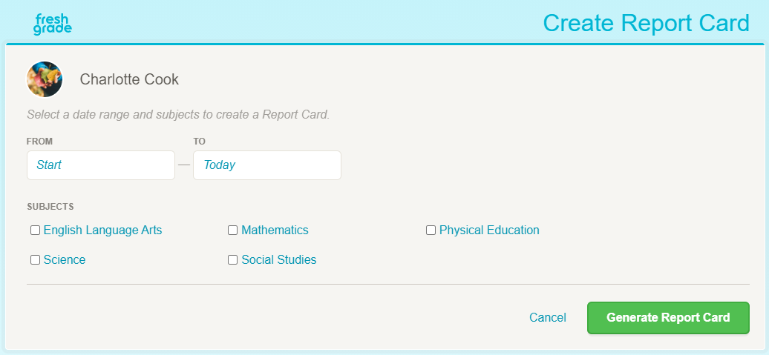
Reporting, including report cards can be automatically generated using the criteria and feedback already entered.
They can also be customized.
Exported class results:

Slide 12
Professional Reviews of FreshGrade: https://privacy.commonsense.org/evaluation/freshgrade
Privacy
“The terms of FreshGrade state they collect Personal Information from students authorized to use the service, such as information that can identify a specific individual, such as a name, address, telephone number, email address, or other information linked to that personal information. In addition, FreshGrade's terms state they collect information only on behalf of the school. The terms also specify that FreshGrade considers student data to be highly confidential and uses this data solely to provide the services to the school. The terms also state FreshGrade may also collect school data which could include school name and location, what grade level and subject matter a teacher's teaches, position within the school, and the type of devices students use in the classroom. FreshGrade's terms specify they collect, store, process, and share student personal information only for the purposes of providing the service, or as authorized by a school or a parent.
The terms of FreshGrade state they do not sell, use, or share student personal information or content for marketing or advertising purposes. However, teachers and parents should be aware that FreshGrade's terms state they may advertise its services to school users and to parents, provided that such advertisements are not be based on student data relating to individually identifiable students. In addition, parents and teachers should be aware FreshGrade's terms state they may permit third party online advertising networks to collect information from visitors. However, although the terms of FreshGrade state they may permit third party advertising partners to collect information on the FreshGrade website for the purpose of sending targeted advertisements, they do not allow third party advertising networks to collect information about students or parents who are logged into the service, or to collect information from our mobile apps.”
Overview
“FreshGrade empowers schools, school districts, teachers, parents, and students to be partners in the education journey. The terms of FreshGrade state parents can track the progress of their child’s learning and students are empowered to take greater ownership of their learning. FreshGrade's terms state they collect Personal Information from students authorized to use the service, such as information that can identify a specific individual, such as a name, address, telephone number, email address, or other information linked to that personal information. The terms specify that FreshGrade has implemented commercially reasonable administrative, physical, and technical safeguards designed to secure Personal Information, including student data, from unauthorized access, disclosure and use. Lastly, the terms of FreshGrade state they do not knowingly collect personal information through the FreshGrade service from a child under 13 until a school or parent has provided appropriate consent and authorization for a student under 13 to use the service and for FreshGrade to collect information.”
Safety
“The terms of FreshGrade state parents can track the progress of their child’s learning and students are empowered to take greater ownership of their learning. The terms specify that students can log-in and view their digital portfolio, self-reflect on their work and work collaboratively with their teachers and parents to achieve their learning goals, as well as capture moments through videos, pictures, audio clips and notes. The FreshGrade terms specify the service may allow users to use the FreshGrade service to host public forums or messaging boards for online discussion or message posting. These are public forums, and information that parents and teachers should be aware may be available to other members of the FreshGrade service or the public.
In addition, each student and his or her parent will only have access to view or submit information relative to that particular student. Neither students nor their parents will be able to view or otherwise access the personal information of other students, unless it is provided to that student account by the School (for example, a class photo and class roster containing the names and photos of other students may be added by a teacher to a student account).”

